Slide 1
Secure Data Hiding in images using steganography
CAPSTONE PROJECT
Presented By:
Student Name : Raja Rajeshwari J
College Name & Department : Chennai Institute of Technology B.E. Electronics and Communication Engineering

Slide 2
OUTLINE
Problem Statement
Technology used
Wow factor
End users
Result
Conclusion
Git-hub Link
Future scope

Slide 3
Problem Statement
In today's digital world, sensitive information is often transmitted online, making it vulnerable to interception, hacking, and unauthorized access. Traditional encryption methods can raise suspicion, as encrypted messages stand out. Cybercriminals can exploit unsecured communication channels, leading to data breaches and privacy violations. There is a need for a covert method to securely transmit confidential information without drawing attention.

Slide 4
Technology used
PROGRAMMING LANGUAGE & FRAMEWORK
Python – Core implementation of steganography
Flask – Backend framework for web-based encryption and decryption
HTML/CSS/JavaScript – Frontend for user interface and interaction
LIBRARIES USED
OpenCV – Image processing for encoding and decoding messages
NumPy – Efficient pixel manipulation and binary conversion
io – Handling in-memory file operations
Flask (Request, Response, jsonify, send_file) – API handling and data transmission
PLATFORMS & HOSTING
Render – Cloud hosting for deploying the web application
GitHub – Version control and code management

Slide 5
Wow factors
Unique Features
User-Friendly GUI – Allows easy text embedding and extraction from images through a simple interface.
Password Protection – Messages can be encrypted with a password for enhanced security.
Real-Time Processing – Quick encoding and decoding with efficient algorithms.
Multi-File Support – Supports multiple image formats (JPG, PNG, etc.).
Secure Handling – Uploaded images are not stored on the server, ensuring privacy and security.
Responsive Design – The website is mobile-friendly and adapts to different screen sizes for a seamless user experience.

Slide 6
End users
Journalists & Whistleblowers: Communicating securely without raising suspicion.
Data Security Professionals: Testing and improving hidden communication methods.
Cybersecurity Enthusiasts: Learning about steganography in an interactive way.
Students & Educators – Learning about cybersecurity, cryptography, and steganography through hands-on experience.
Law Enforcement & Intelligence Agencies – Securely transmitting sensitive information without attracting attention.
Corporate Professionals – Protecting confidential business communications or intellectual property.
General Users: Sending hidden messages in images for privacy or fun.

Slide 7
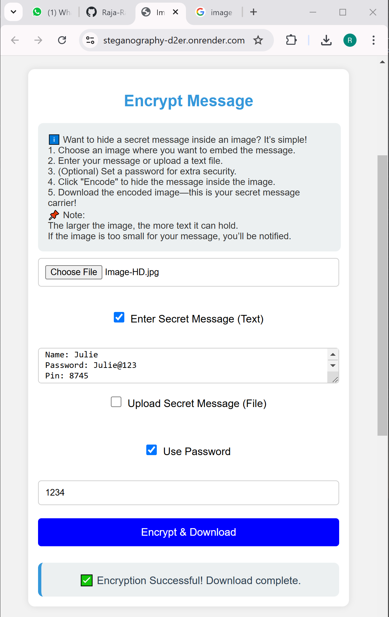
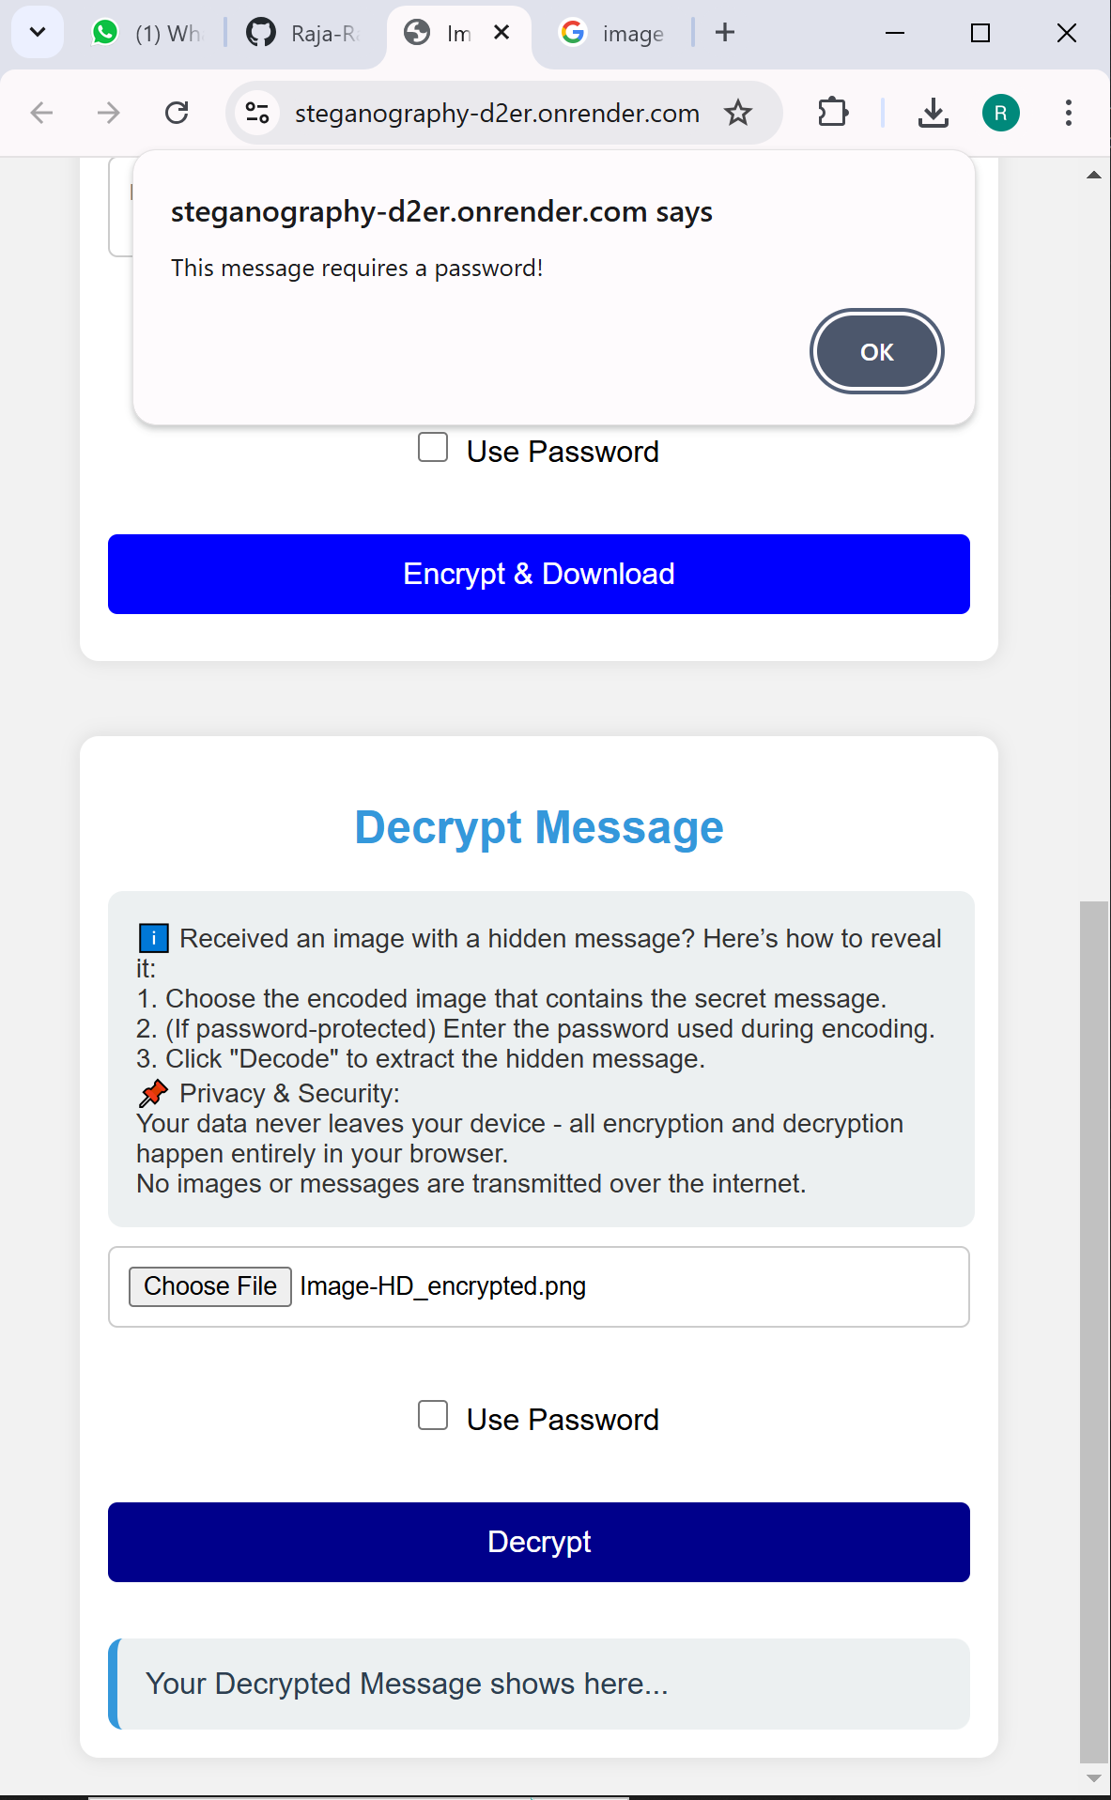
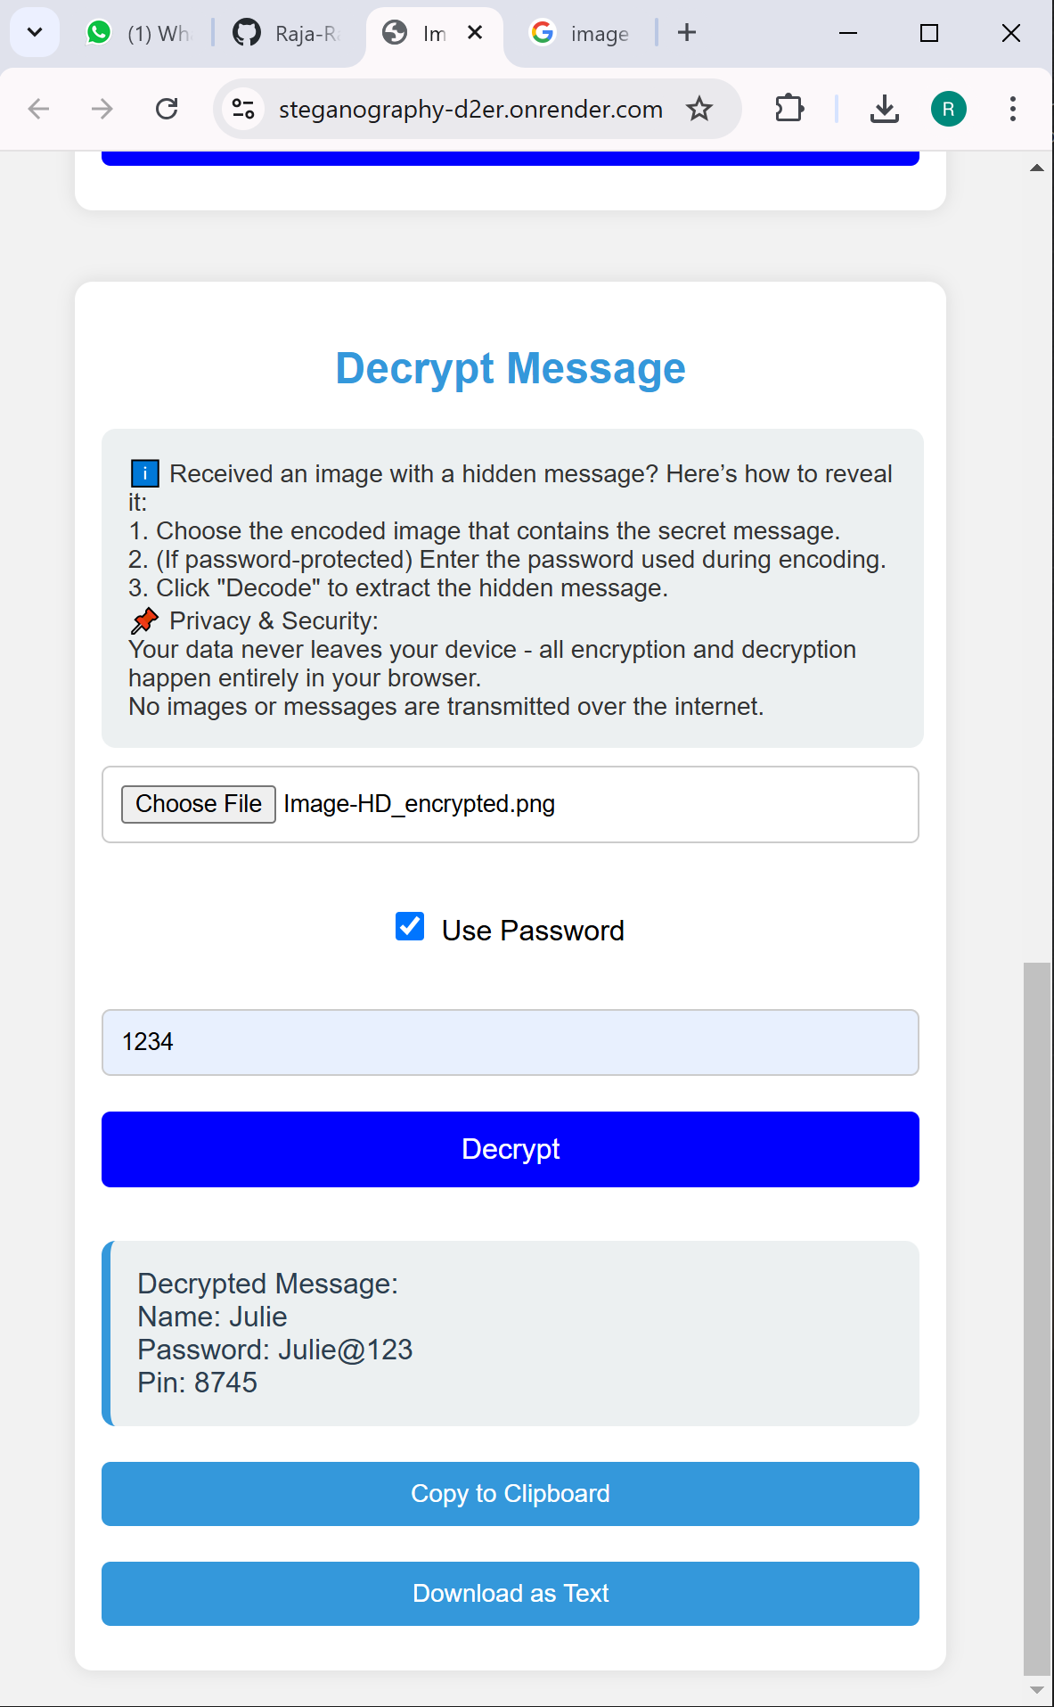
Results
Successful Decryption
Successful Encryption Decryption without password (when required)

Slide 8
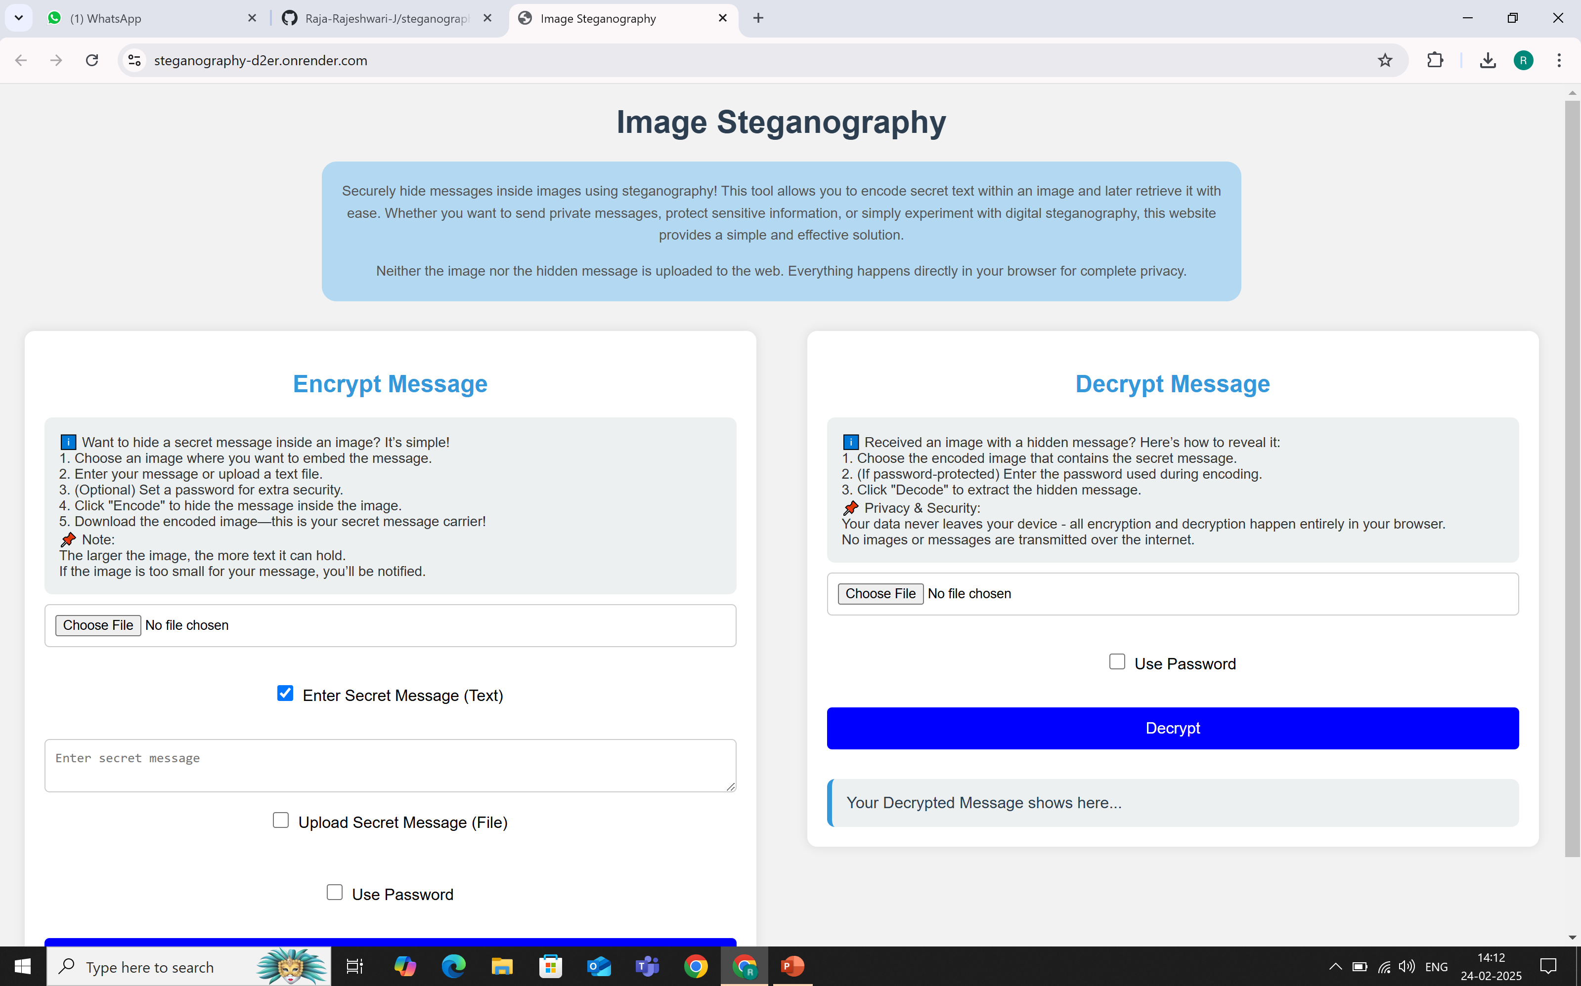


Results
Image before Encryption (Image-HD.jpg)
Responsive User Interface (UI)
Image after Encryption (Image-HD_encrypted.png)

Slide 9
Conclusion
This steganography project successfully addresses the challenge of securely hiding and transmitting sensitive information within images. By leveraging LSB-based encoding, password protection, and a user-friendly web interface, it ensures confidentiality while maintaining image integrity. The real-time encryption and decryption process enhances usability, making it accessible for both security-conscious users and general audiences. With the added security of not storing uploaded images on the server, the system prioritizes privacy. This project demonstrates the practical application of steganography in modern digital communication, paving the way for further enhancements in secure messaging.

Slide 10
GitHub Link
https://github.com/Raja-Rajeshwari-J/steganography.git
LIVE DEMO Link
https://steganography-d2er.onrender.com

Slide 11
Future scope
Steganography in Live Streams – Embedding secret messages in real-time audio/video streams for secure and undetectable communication.
Advanced Encryption Integration (AES, RSA) – Enhancing security by combining steganography with strong encryption methods.
Multi-Layered Steganography – Distributing hidden data across images, audio, and video to resist detection.
Blockchain-Based Verification – Ensuring message integrity and authenticity using blockchain.
Mobile App Development – Creating a dedicated Android & iOS app for on-the-go encryption & decryption.
Cross-Platform Compatibility – Expanding support to Mac, Linux, and mobile devices for wider accessibility.
Enhancing Performance for Larger Files – Enhancing speed and efficiency for processing larger files securely.

Slide 12
THANK YOU

